Slide 1
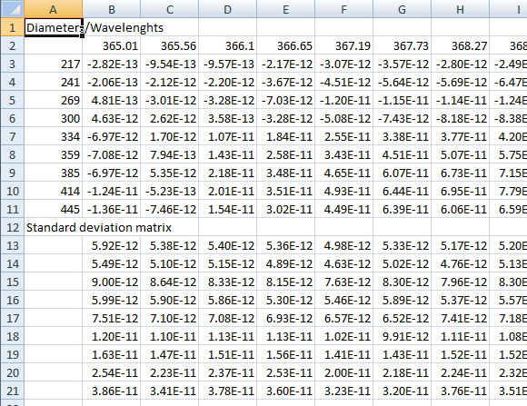
Diameter (nm)
Header
Wavelengths (nm)
Extinction Cross(cm^2)
Header
Extinction Cross(cm^2)
Uncertainties

Slide 2
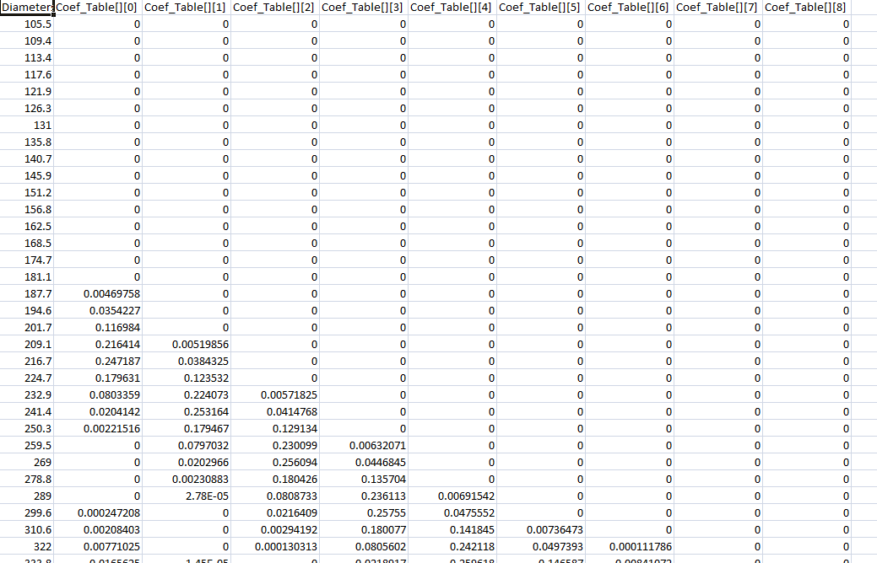
Diameter (nm)
Second Selected size
First Selected size

Slide 3
